Slide 1
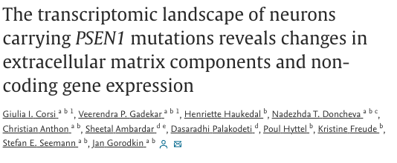
Studying the A79V Mutation in PSEN1
Surya Vishnubhatt

Slide 2
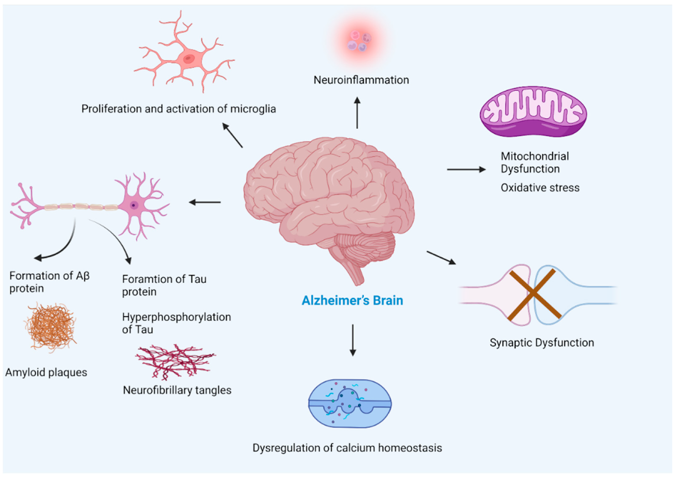
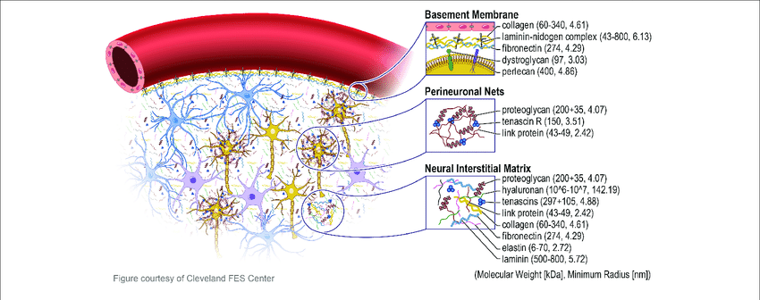
Background
Alzheimer’s Disease is the leading cause of dementia worldwide
PSEN1 is a gene involved in processing amyloid precursor protein known to be linked to familial Alzheimer’s
Hypothesis: A79V mutation in PSEN1 leads to changes in coding genes associated with ECM components in neurons.
Notes:
Links:
https://www.researchgate.net/figure/Extracellular-matrix-in-brain-The-extracellular-matrix-ECM-in-the-brain-is-divided_fig1_326445731

Slide 3
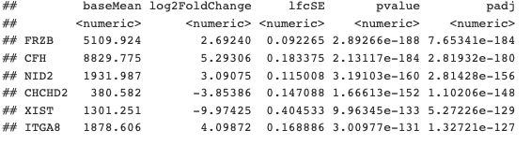
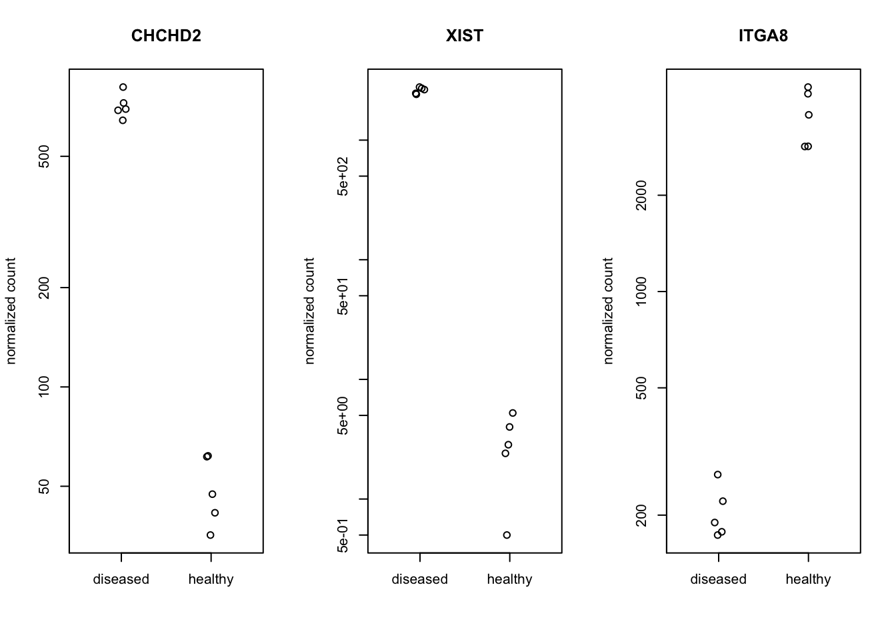
Methods and DeSeq Results
QC:
fastqc
multiqc
Bamqc
qorts
Processing:
DeSeq
PCA
GO Enrichment via ClusterProfiler

Slide 4
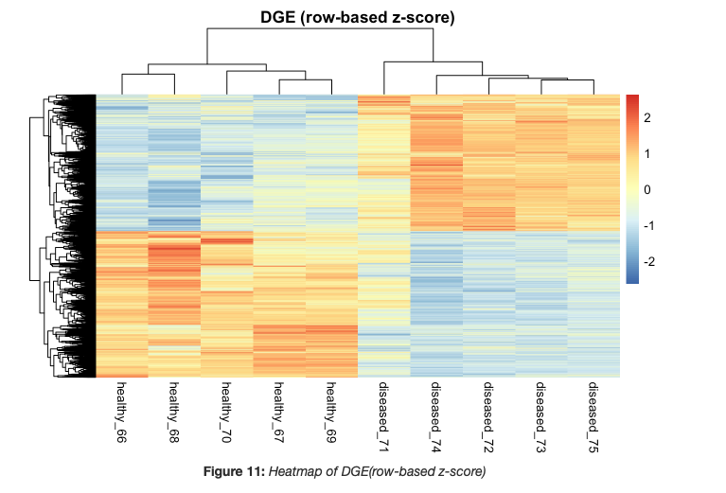
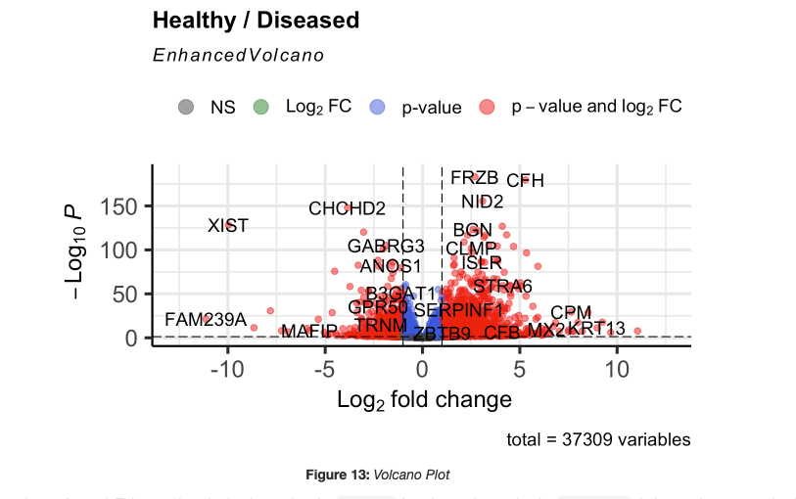
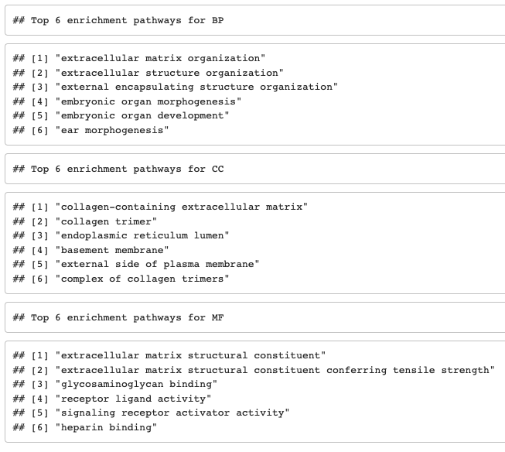
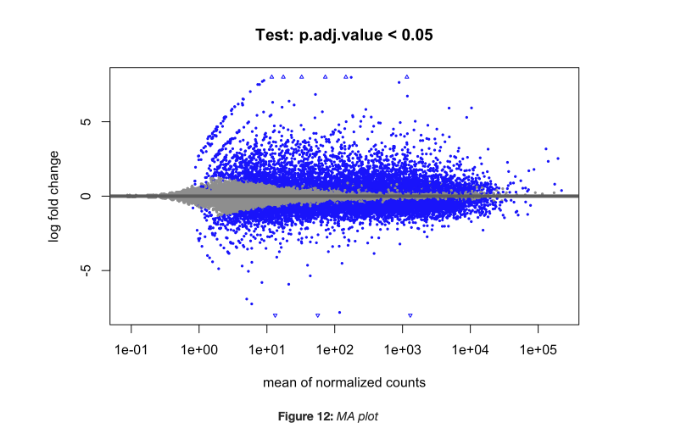
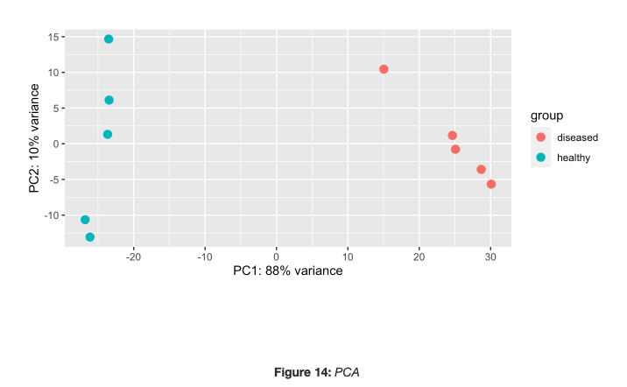
Results (contd.)

Slide 5
Discussion/Conclusions
Results seem to support hypothesis that A79V mutation in PSEN1 leads to changes in expression for coding genes associated with ECM components
Limitations:
Sample Size, Lack of Variation
Potential Improvements:
Larger Data Pool and Pipeline
KEGG Enrichment
Challenges Faced:
Interleaved Format During ENA Accession, used fastq-dump to obtain files

